Slide 1

Mental health analysing website
(“Mending Minds”)
Guided by:-
Dr. Varshali Jaiswal Mam

Slide 2
CONTENTS OF THIS PRESENTATION
1.Introduction
6. Hardware & Software requirements
2. EXISTING WORK WITH LIMITATION
7. Overall system architecture diagram.
3. Proposed work and methodology
8. Implementation and coding.
4. Novelty of the project
Venus
9. Result and Discussion
5. Real time usage and advantages
10. Conclusion

Slide 3
INTRODUCTION
Mental Stress
Stress is a feeling of emotional or physical tension.
Stress is your body’s reaction to a challenge or demand.
Your body reacts to stress by releasing hormones
The project theme is based on mental health issues particularly, mental stress which is a topic not talked about often but can lead to many other mental health issues if not treated on time.
Website will be making use of hardware and other software tools to make it interactive and convenient for the user so that they can become aware of their stress levels and can get remedy.

Slide 4
Collecting medical history using equipments.
Recognising patient’s facial expressions to analyse their emotional state.
Website will be analysing the current situation of their mental state and according to that stress levels will be determined and prescribe or guide them accordingly.
Can also connect doctors with the website so as to provide on the spot guidance if the patient wants further consultancy.

Slide 5
2. Existing work with limitations
EXISTING METHODS:
Physiological signals, including galvanic skin response and skin temperature, that are related to such activities, can provide insights into ANS activity and are considered to be reliable indicators of stress.
Smart sensor devices that can be worn in daily routine do help in detecting our body temperature, heart rate, blood pressure and stress levels.
Mental health checkup by a certified psychologist or therapist can help in accurate detection and is remedial for long run

Slide 6
DRAWBACKS:
Previous approaches indicate that the combination of several physiological signals does not ensure the highest possible accuracy.
Sensor devices seldomly provide inaccurate data which can alter stress level results and can lead to wrong conclusions.
Going for a mental health checkup may take more than a single session for recognizing the root cause for stress or stress itself in the first place.
Most of the people do not have time to take therapy sessions as they have busy routine.
Therapy is expensive for many people.

Slide 7
3. Proposed work and methodology
START
WEBSITE
LOGIN
DETAILS
QUESTIONS
BLOOD PRESSURE AND OXIMETER
FACE DETECTION
RESULT STRESS LEVEL
NORMAL
HIGH
CONTACT OF FREE COUNSELLING SERVICES /
PAYMENT GATEWAY FOR PAID COUNSELLING SERVICES
END

Slide 8
4. Novelty of the project
There are many mental health surveying websites across internet but our website stands apart as questions of the quiz specifically focus on day to day personal, professional and societal based questions which helps in analysing the mental state of a person more accurately.
Personalised results based on quiz, medical history and facial expression analyser.
Providing helplines of government for further help in consultation.
Also providing some common ways to cope up with stress in our day to day lives.

Slide 9
5. Real time usage and advantages
Awareness about one’s own mental health
Detects signs and symptoms, medical issue or anxiety disorder
Helps schedule daily routine
Solution to relieve stress
Helps in effective cognition of stress
Atrophy of brain regions, resulting from repeated exposure to stressful conditions, has a cognitive cost. Everyday life events and daily stressors are associated with cognitive failures such as losing one's keys , forgetting to take medication etc.
Indeed, working memory, attention, response inhibition and cognitive flexibility have all been found to be impaired by stress
Stress can affect cognition in many ways, with the outcome (i.e., facilitating or impairing) depending on a combination of factors related to both stress and the cognitive function under study

Slide 10
Increase self mental health awareness in an individual
Self-awareness helps you recognize negative feelings and take action to improve how you feel. For example: "When we are aware we are stressed, we can take steps to reduce stressful activities. We can also activate stress relievers such as engaging in pleasurable activities, seeking connections with others, resting, or being active."
Helps achieving a better schedule
Better stress levels lead to improved mental health, more time to relax and less anxiety. A lack of healthy stress management techniques can put you at greater risk for heart disease and negatively impact your overall health.
The test can be taken at any time from the comfort of home
One of the best things you can do for your mental health is speak to a mental health professional, but sometimes in-person care can be expensive or inaccessible.
Is way cheaper than therapy

Slide 11
6. Hardware & Software requirements
Languages used:
HTML
CSS
JAVA Script
PYTHON
Software used:
VS Code
Pycharm
Figma
Google Chrome
Hardware used:
Smartwatch (for taking readings of patient’s heart rate, body temperature nd oxygen level)
Blood Pressure Monitoring Machine (for taking readings of patient’s blood pressure)
Webcam (for the recognition of patient’s facial expressions)

Slide 12
7. Overall system architecture diagram.
Architecture serves as a blueprint for a system. It provides an abstraction to manage the system complexity and establish a communication and coordination mechanism among components.
● It defines a structured solution to meet all the technical and operational requirements, while optimizing the common quality attributes like performance and security.
● Further, it involves a set of significant decisions about the organization related to software development and each of these decisions can have a considerable impact on quality, maintainability, performance, and the overall success of the final product.
These decisions comprise of −
○ Selection of structural elements and their interfaces by which the system is composed.
○ Behavior as specified in collaborations among those elements.
○ Composition of these structural and behavioral elements into a large subsystem.
○ Architectural decisions align with business objectives.
○ Architectural styles guide the organization.

Slide 13
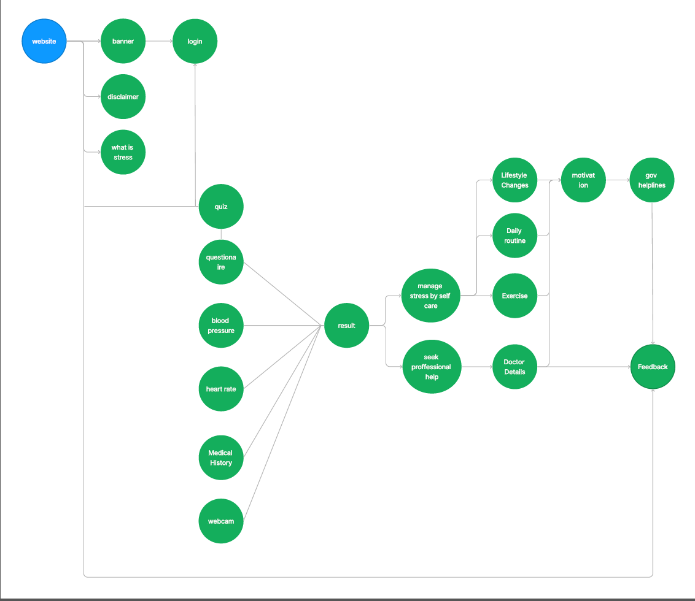

Slide 14
8. Implementation and coding.
Code Snippet for Facial Expression Recognition from Webcam
from fer import Video
from fer import FER
import os
import sys
import pandas as pd
# Putting in the location of the video file that has to be processed
location_videofile = "C:\\Users\\anany\\OneDrive\\Pictures\\Camera Roll\\WIN_20220901_20_36_47_Pro.mp4"
# Building of the Face detection detector
face_detector = FER(mtcnn=True)
# Input the video for processing
input_video = Video(location_videofile)
# The Analyze() function will run analysis on every frame of the input video.
# It will create a rectangular box around every image and show the emotion values next to that.
# Finally, the method will publish a new video that will have a box around the face of the human with live emotion values.
processing_data = input_video.analyze(face_detector, display=False)

Slide 15
# We will now convert the analysed information into a dataframe.
# This will help us import the data as a .CSV file to perform analysis over it later
vid_df = input_video.to_pandas(processing_data)
vid_df = input_video.get_first_face(vid_df)
vid_df = input_video.get_emotions(vid_df)
# Plotting the emotions against time in the video
pltfig = vid_df.plot(figsize=(20, 8), fontsize=16).get_figure()
# We will now work on the dataframe to extract which emotion was prominent in the video
angry = sum(vid_df.angry)
disgust = sum(vid_df.disgust)
fear = sum(vid_df.fear)
happy = sum(vid_df.happy)
sad = sum(vid_df.sad)
surprise = sum(vid_df.surprise)
neutral = sum(vid_df.neutral)
emotions = ['Angry', 'Disgust', 'Fear', 'Happy', 'Sad', 'Surprise', 'Neutral']
emotions_values = [angry, disgust, fear, happy, sad, surprise, neutral]
score_comparisons = pd.DataFrame(emotions, columns = ['Human Emotions'])
score_comparisons['Emotion Value from the Video'] = emotions_values
score_comparisons

Slide 16
Code snippet for quiz
# Python program to create a simple GUI
# Simple Quiz using Tkinter
#import everything from tkinter
from tkinter import *
# and import messagebox as mb from tkinter
from tkinter import messagebox as mb
#import json to use json file for data
import json
#class to define the components of the GUI
class Quiz:
# This is the first method which is called when a
# new object of the class is initialized. This method
# sets the question count to 0. and initialize all the
# other methoods to display the content and make all the
# functionalities available
def __init__(self):

Slide 17
# set question number to 0
self.q_no=0
# assigns ques to the display_question function to update later.
self.display_title()
self.display_question()
# opt_selected holds an integer value which is used for
# selected option in a question.
self.opt_selected=IntVar()
# displaying radio button for the current question and used to
# display options for the current question
self.opts=self.radio_buttons()
# display options for the current question
self.display_options()

Slide 18
# displays the button for next and exit.
self.buttons()
# no of questions
self.data_size=len(question)
# keep a counter of correct answers
self.correct=0
# This method is used to display the result
# It counts the number of correct and wrong answers
# and then display them at the end as a message Box
def display_result(self):

Slide 19
# calculates the wrong count
wrong_count = self.data_size - self.correct
correct = f"Correct: {self.correct}"
wrong = f"Wrong: {wrong_count}"
# calcultaes the percentage of correct answers
score = int(self.correct / self.data_size * 100)
result = f"Score: {score}%"
# Shows a message box to display the result
mb.showinfo("Result", f"{result}\n{correct}\n{wrong}")
# This method checks the Answer after we click on Next.
def check_ans(self, q_no):

Slide 20
# checks for if the selected option is correct
if self.opt_selected.get() == answer[q_no]:
# if the option is correct it return true
return True
# This method is used to check the answer of the
# current question by calling the check_ans and question no.
# if the question is correct it increases the count by 1
# and then increase the question number by 1. If it is last
# question then it calls display result to show the message box.
# otherwise shows next question.
def next_btn(self):
# Check if the answer is correct
if self.check_ans(self.q_no):

Slide 21
# if the answer is correct it increments the correct by 1
self.correct += 1
# Moves to next Question by incrementing the q_no counter
self.q_no += 1
# checks if the q_no size is equal to the data size
if self.q_no==self.data_size:
# if it is correct then it displays the score
self.display_result()
# destroys the GUI
gui.destroy()
else:
# shows the next question
self.display_question()
self.display_options()

Slide 22
# This method shows the two buttons on the screen.
# The first one is the next_button which moves to next question
# It has properties like what text it shows the functionality,
# size, color, and property of text displayed on button. Then it
# mentions where to place the button on the screen. The second
# button is the exit button which is used to close the GUI without
# completing the quiz.
def buttons(self):
# The first button is the Next button to move to the
# next Question
next_button = Button(gui, text="Next",command=self.next_btn,
width=10,bg="blue",fg="white",font=("ariel",16,"bold"))
# placing the button on the screen
next_button.place(x=350,y=380)
# This is the second button which is used to Quit the GUI
quit_button = Button(gui, text="Quit", command=gui.destroy,
width=5,bg="black", fg="white",font=("ariel",16," bold"))

Slide 23
# placing the Quit button on the screen
quit_button.place(x=700,y=50)
# This method deselect the radio button on the screen
# Then it is used to display the options available for the current
# question which we obtain through the question number and Updates
# each of the options for the current question of the radio button.
def display_options(self):
val=0
# deselecting the options
self.opt_selected.set(0)
# looping over the options to be displayed for the
# text of the radio buttons.
for option in options[self.q_no]:
self.opts[val]['text']=option
val+=1
# This method shows the current Question on the screen
def display_question(self):

Slide 24
# setting the Question properties
q_no = Label(gui, text=question[self.q_no], width=60,
font=( 'ariel' ,16, 'bold' ), anchor= 'w' )
#placing the option on the screen
q_no.place(x=70, y=100)
# This method is used to Display Title
def display_title(self):
# The title to be shown
title = Label(gui, text="Stress Analyzer QUIZ",
width=50, bg="green",fg="white", font=("ariel", 20, "bold"))
# place of the title
title.place(x=0, y=2)

Slide 25
# This method shows the radio buttons to select the Question
# on the screen at the specified position. It also returns a
# list of radio button which are later used to add the options to
# them.
def radio_buttons(self):
# initialize the list with an empty list of options
q_list = []
# position of the first option
y_pos = 150
# adding the options to the list
while len(q_list) < 4:
# setting the radio button properties
radio_btn = Radiobutton(gui,text=" ",variable=self.opt_selected,
value = len(q_list)+1,font = ("ariel",14))

Slide 26
9. RESULT AND DISCUSSION
Result:
Website quiz evaluating the result and showing correct mental stress level of the user.
Website facial recognition webcam feature helping analysing stress through expressions.
Website “Mending minds” fully capable of analysing mental stress levels of the user.
Discussion:
We aim to have our university's students as our current target audience in order to understand what else we can integrate once the website is full-fledged working in order to make it the one stop place for students to get all mental health related information whether it be their stress levels affected by personal, physical, societal conditions; psychiatrist, helplines and some common ways to cope up any conditions related to their mental health.

Slide 27
10. CONCLUSION
Mental health is an integral part of health; it is more than the absence of mental illnesses. It is the foundation for well-being and effective functioning of individuals. It includes mental well-being, prevention of mental disorders, treatment and rehabilitation. That’s why through this website we are trying to provide a first aid help to tackle the mental health stigma in our society. We aim to have our university's students as our current target audience in order to understand what else we can integrate once the website is full-fledged working in order to make it the one stop place for students to get all mental health related information whether it be their stress levels affected by personal, physical, societal conditions; psychiatrist, helplines and some common ways to cope up any conditions related to their mental health.

Slide 28
11. REFERENCES
Article on Building FER https://towardsdatascience.com/the-ultimate-guide-to-emotion-recognition-from-facial-expressions-using-python-64e58d4324ff
Article on Face Detection https://towardsdatascience.com/face-detection-recognition-and-emotion-detection-in-8-lines-of-code-b2ce32d4d5de
Article on Face Emotion Recognition
https://analyticsindiamag.com/face-emotion-recognizer-in-6-lines-o
f -code/
Article on Stress and your Health. Medline Plus. Article by National Library of Medicine Source- https://medlineplus.gov/ency/article/003211.htm#:~:text=Stress%20is%20a%20feeling%20of,danger%20or%20meet%20a%20deadline.
Article on Stress Detecting Methods by National Library of Medicine.
Source-
https://www.ncbi.nlm.nih.gov/pmc/articles/PMC6749249/

Slide 29
TEAM MEMBERS
ANSHIKA SINGH 21BCE10176
SAMYAK MAITRE 21BCE10429
AYUSH KARKARE 21BCE10517
AMEYA SHARMA 21BCE11374
ANANYA TIWARI 21BCE11375

Slide 30
DEMO VIDEO LINK
https://drive.google.com/file/d/1NrfIdM-IWfJJCJNB2elGZP95iDNzZpgQ/view?usp=sharing

Slide 31
THANK YOU!

